Slide 1
TonyMall
Tony P1507921 Demi P1507862
Giulio P1507805 Chris P1507881

Slide 2
Outline
Introduction
ER Diagram
Project Outcome
Product Lists
Purchase Order Processing
Conclusion & Future Work

Slide 3
Introduction

Slide 4
Overview
Online shopping malls are websites that enable retailers to sell in one portal and allow customers to purchase.
Tonymall, which is an online shopping mall selling various kinds of smart phones.
TonyMall has 21 functions for customers and 11 functions for vendors.

Slide 5
ER Diagram

Slide 6
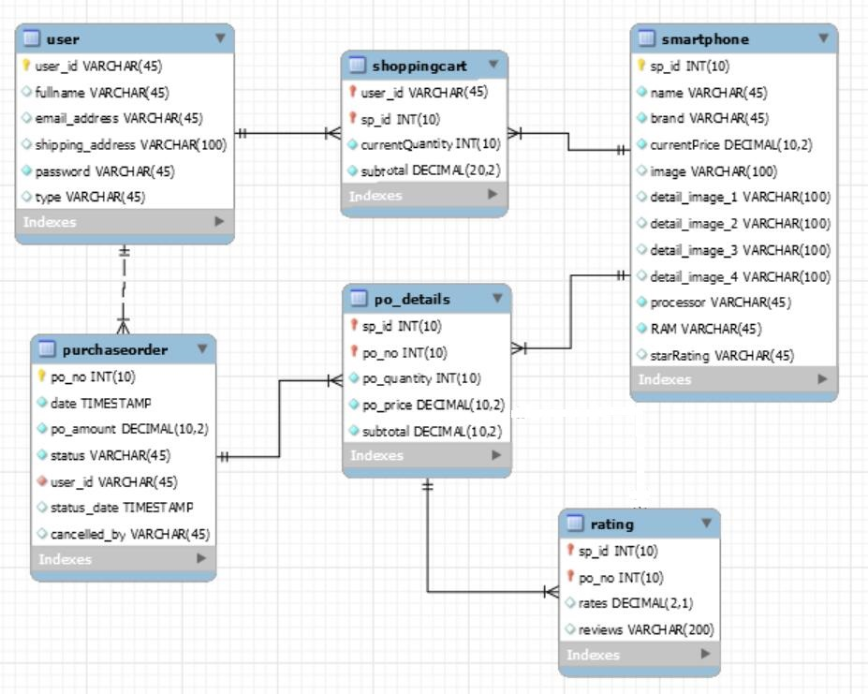

Slide 7
Project Outcome

Slide 8
Customer
Product Lists
Account management
Shopping cart
Purchasing tracking

Slide 9
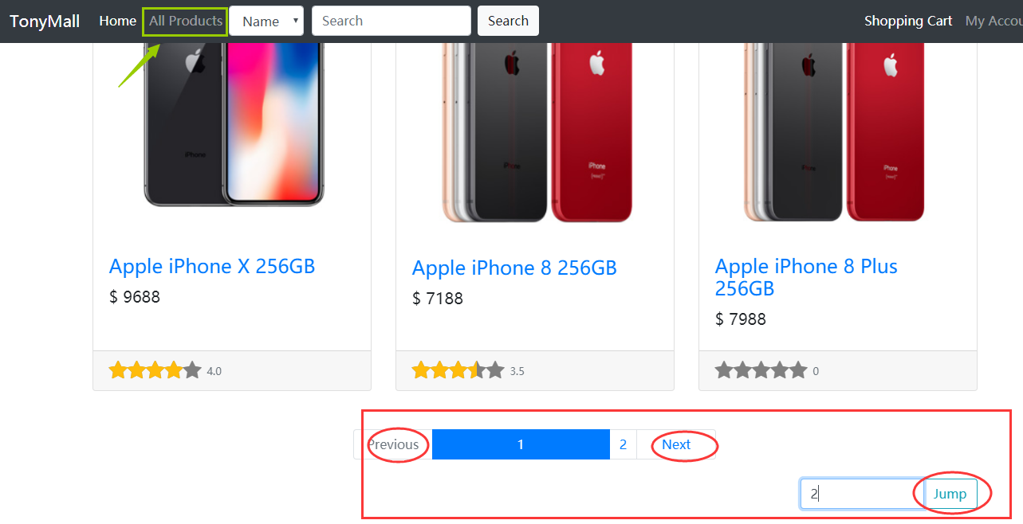
Product list: browsing and paging

Slide 10
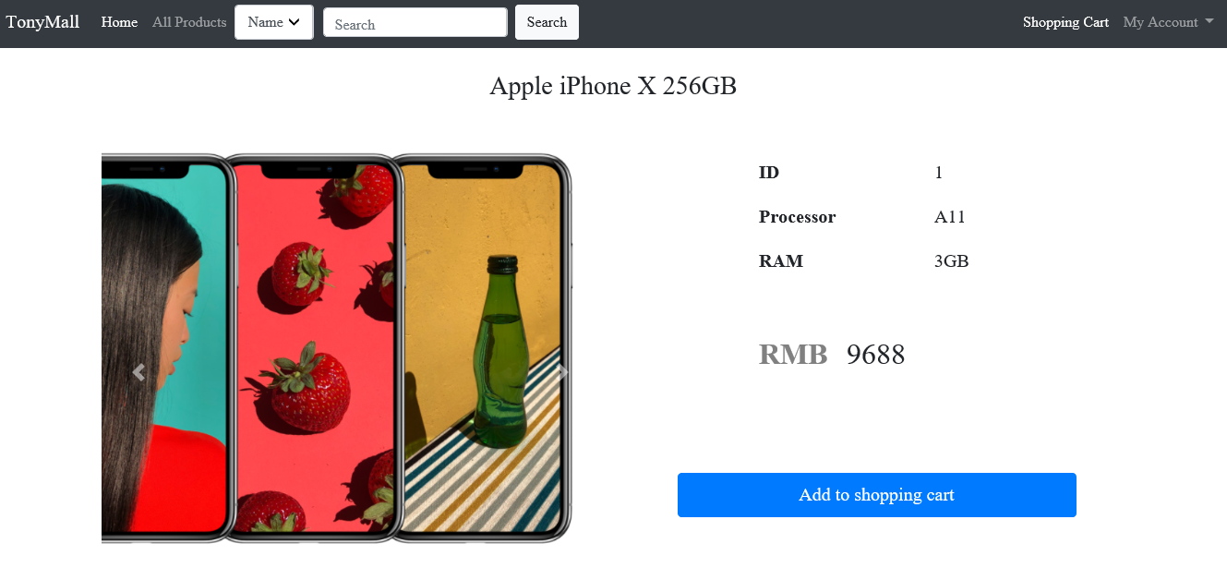
Product list: product detail page

Slide 11
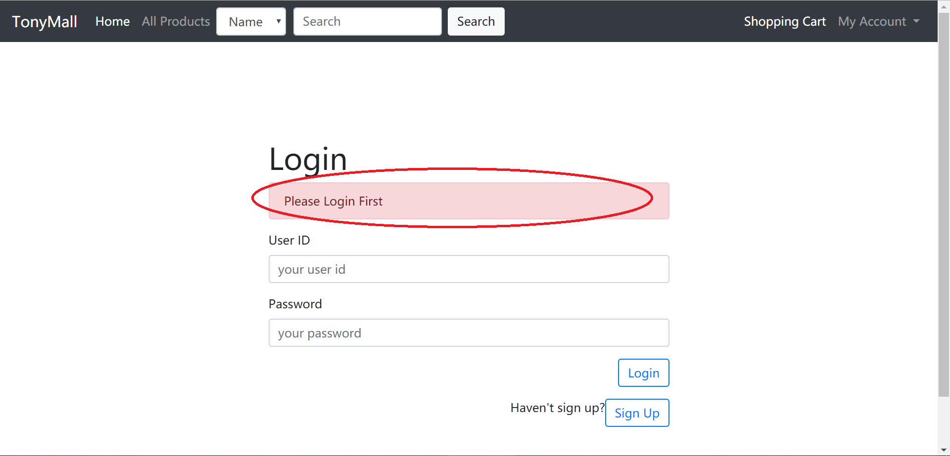
Account management: redirect to login page

Slide 12
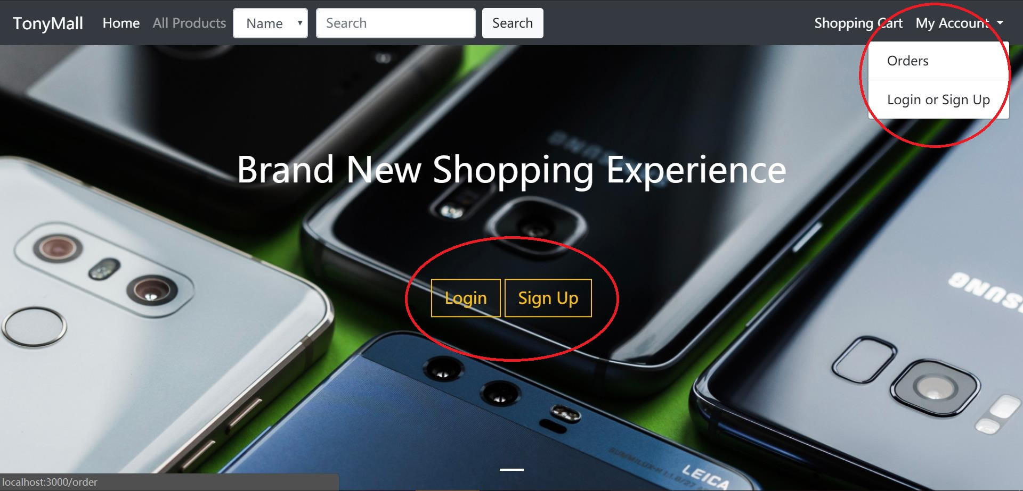
Account management: login & sign up

Slide 13
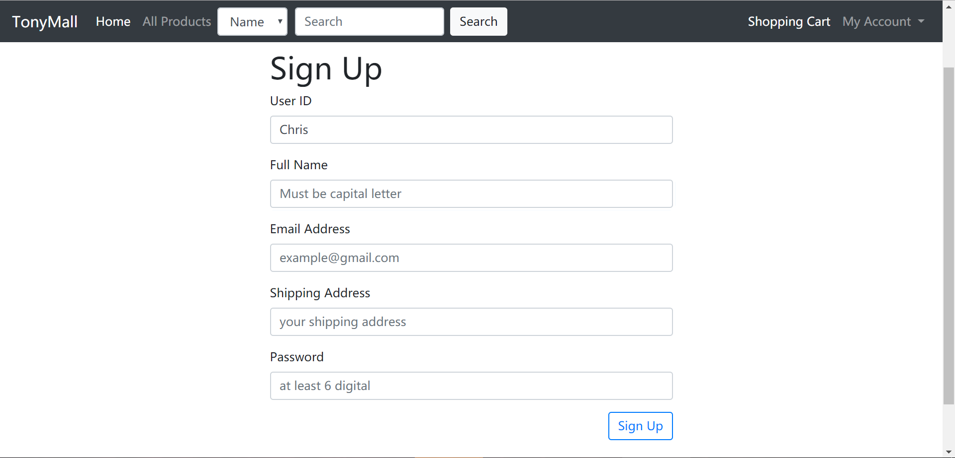
Account management: sign up

Slide 14
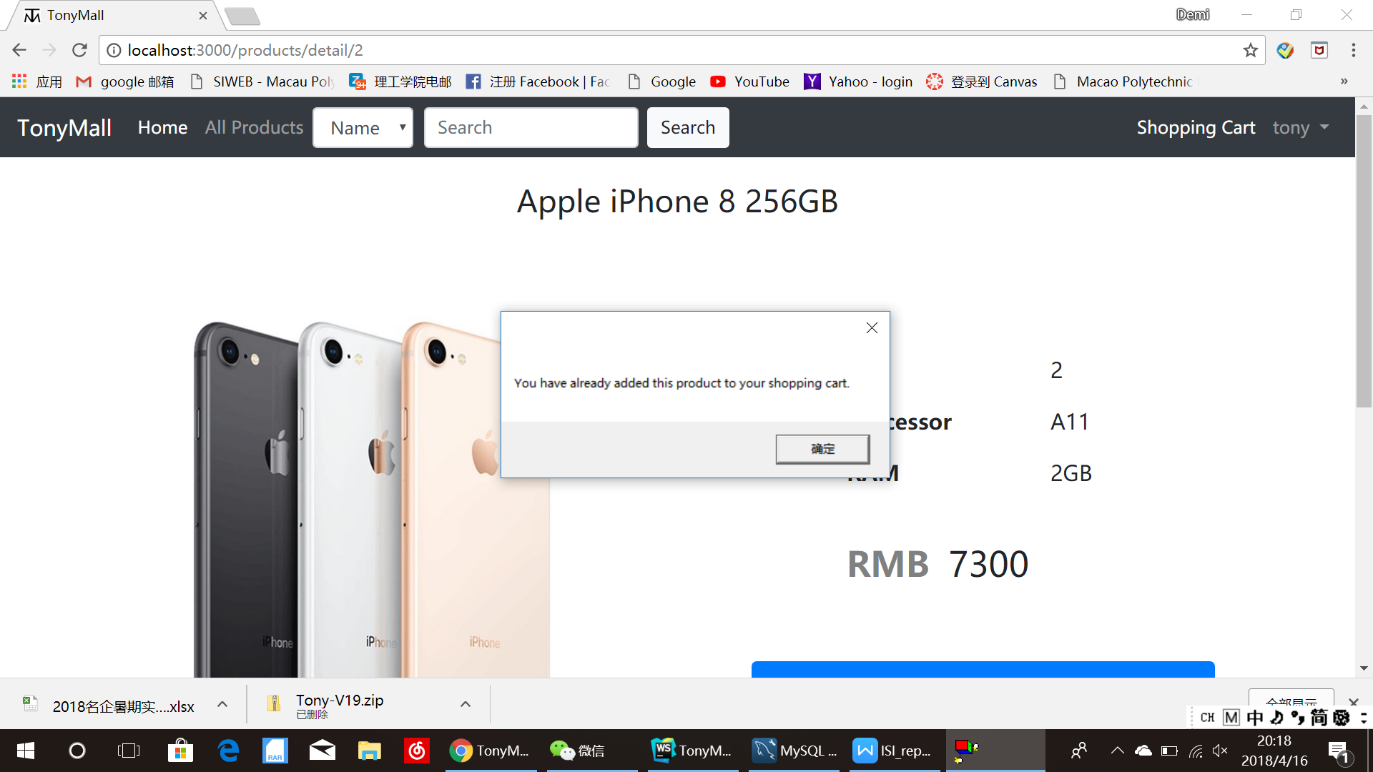
Shopping cart: prevent duplicate product

Slide 15
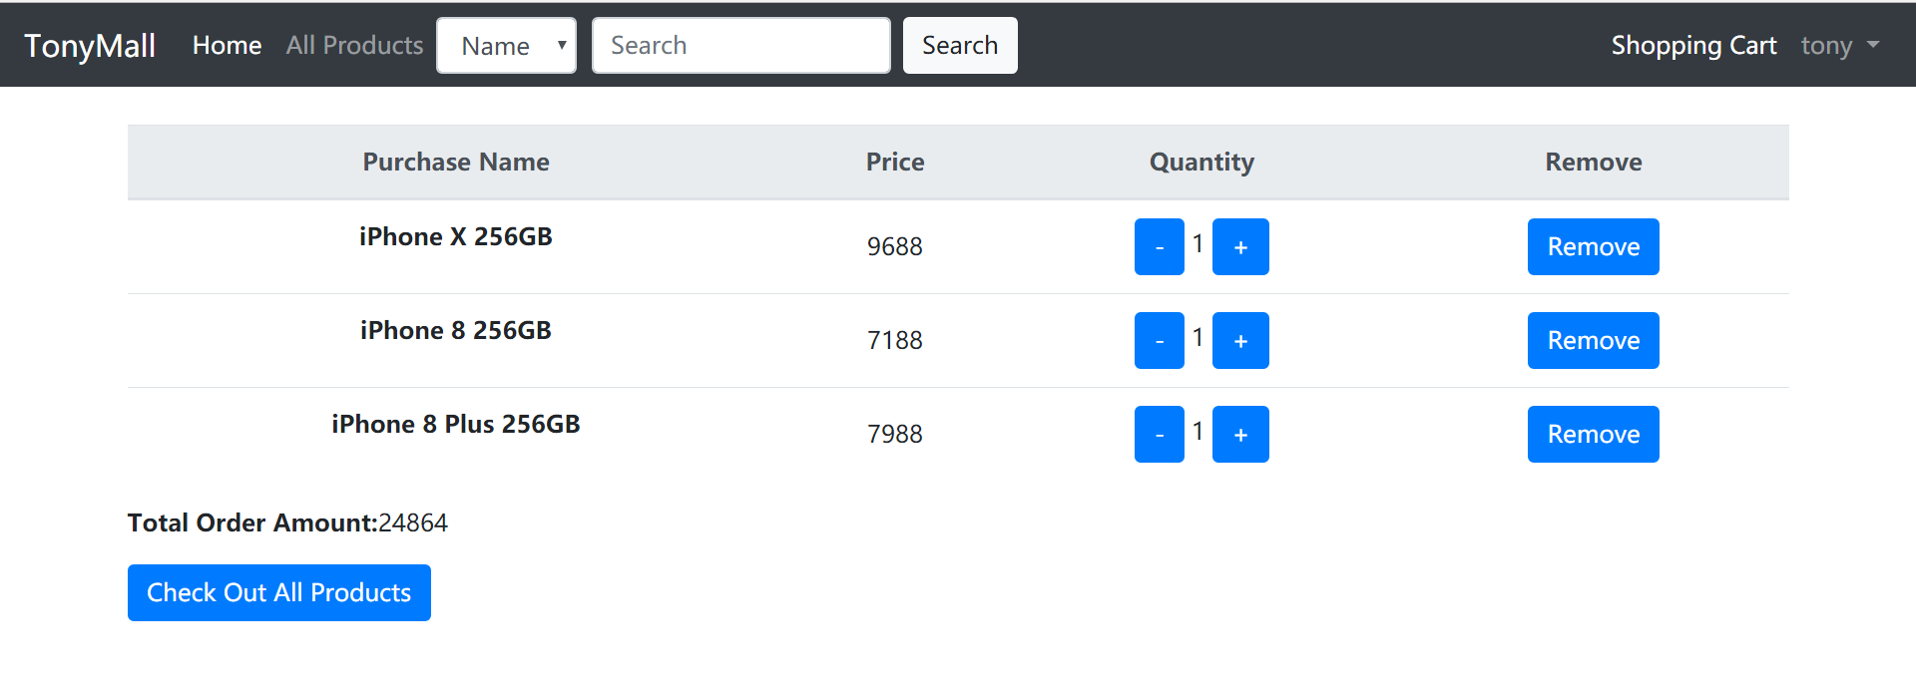
Shopping cart: manage shopping cart

Slide 16
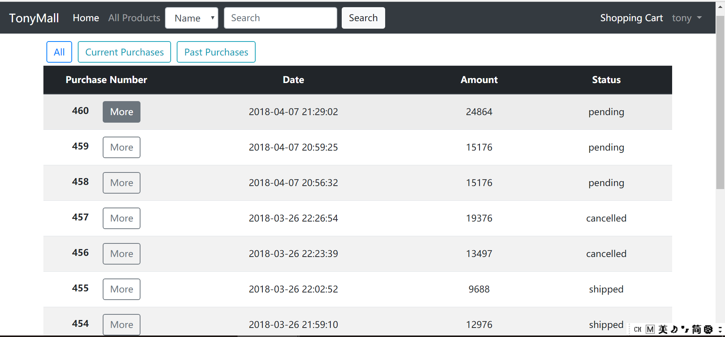
Purchasing tracking: Order list (current & past)

Slide 17
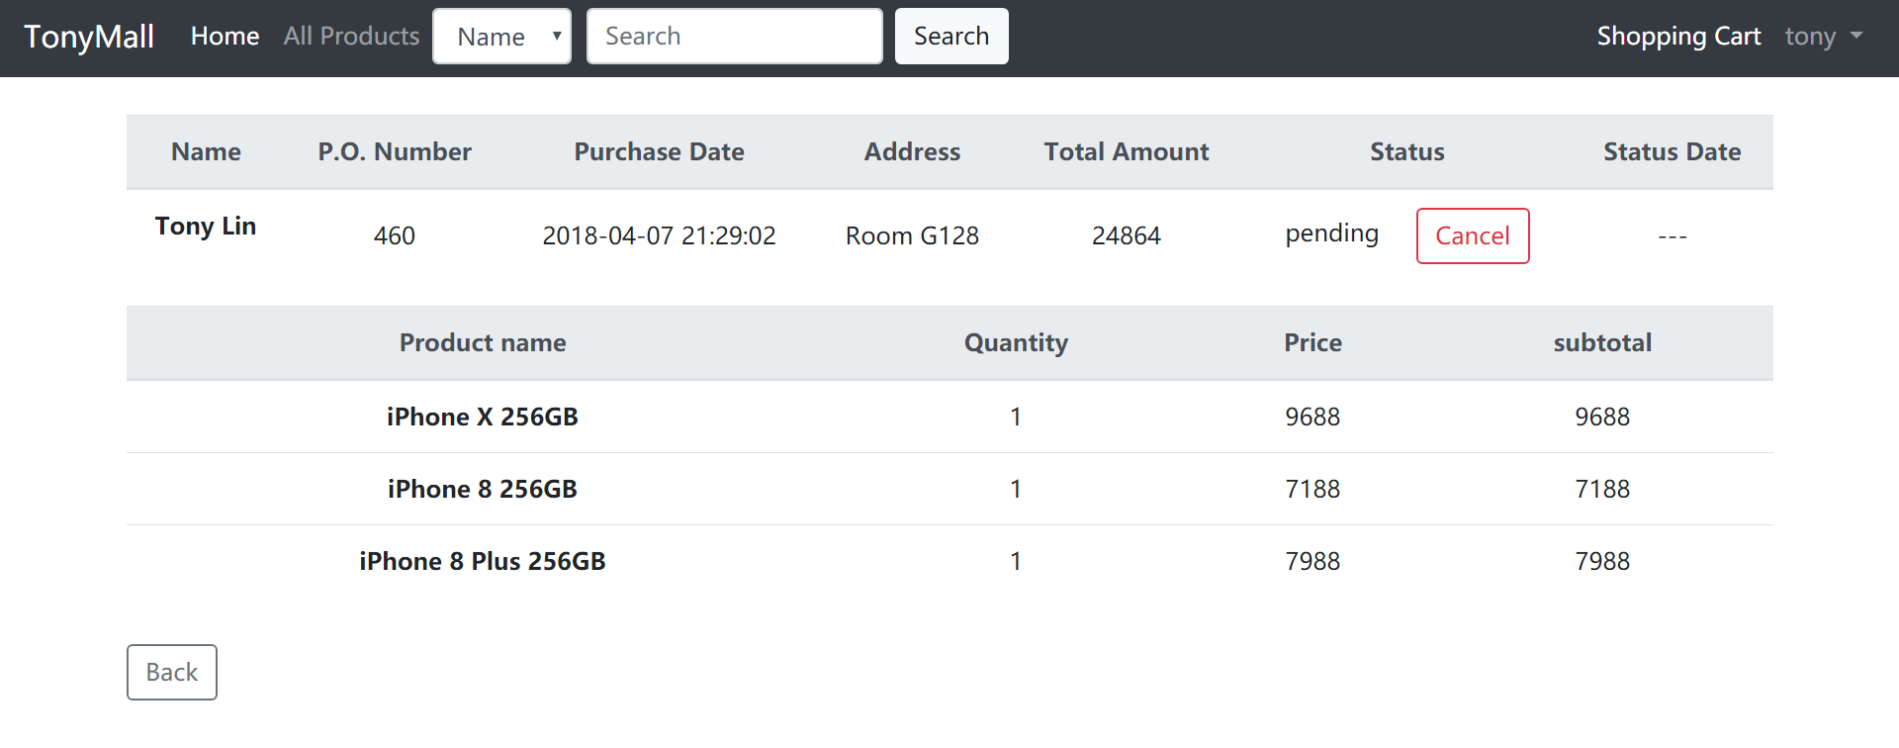
Purchase Order

Slide 18
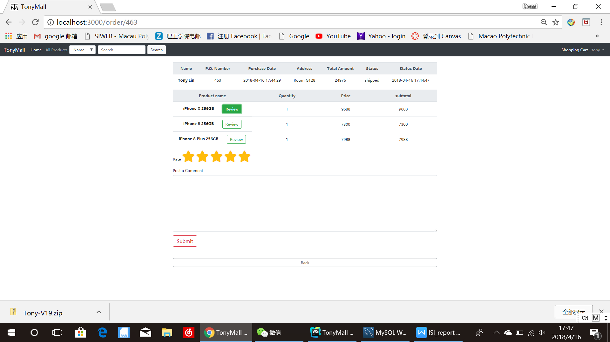
Purchase Order: Rating & Comment

Slide 19
Vendor
Product Lists
Purchase Order Processing

Slide 20
Product Lists

Slide 21
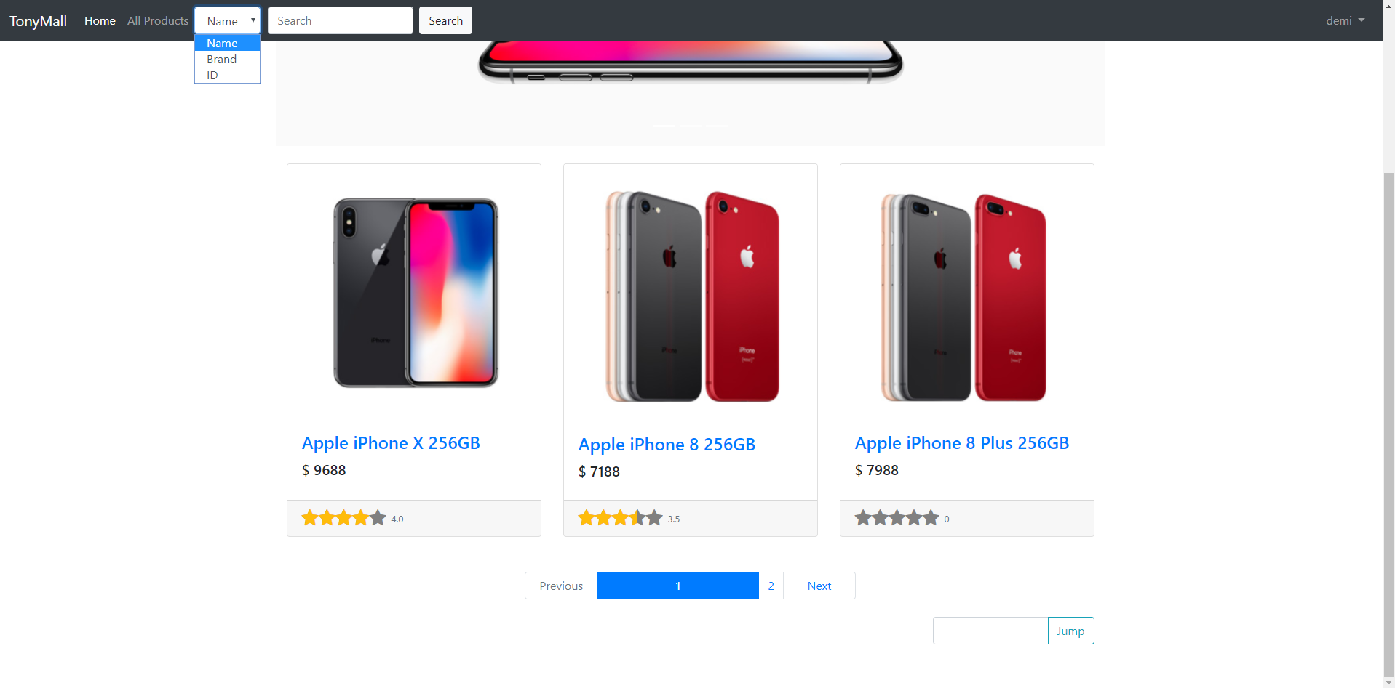

Slide 22
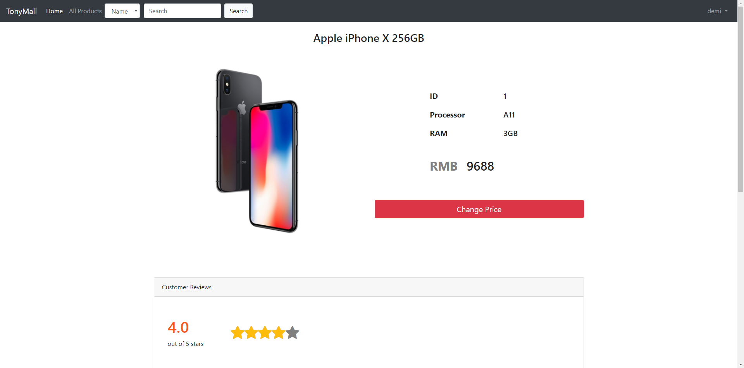

Slide 23
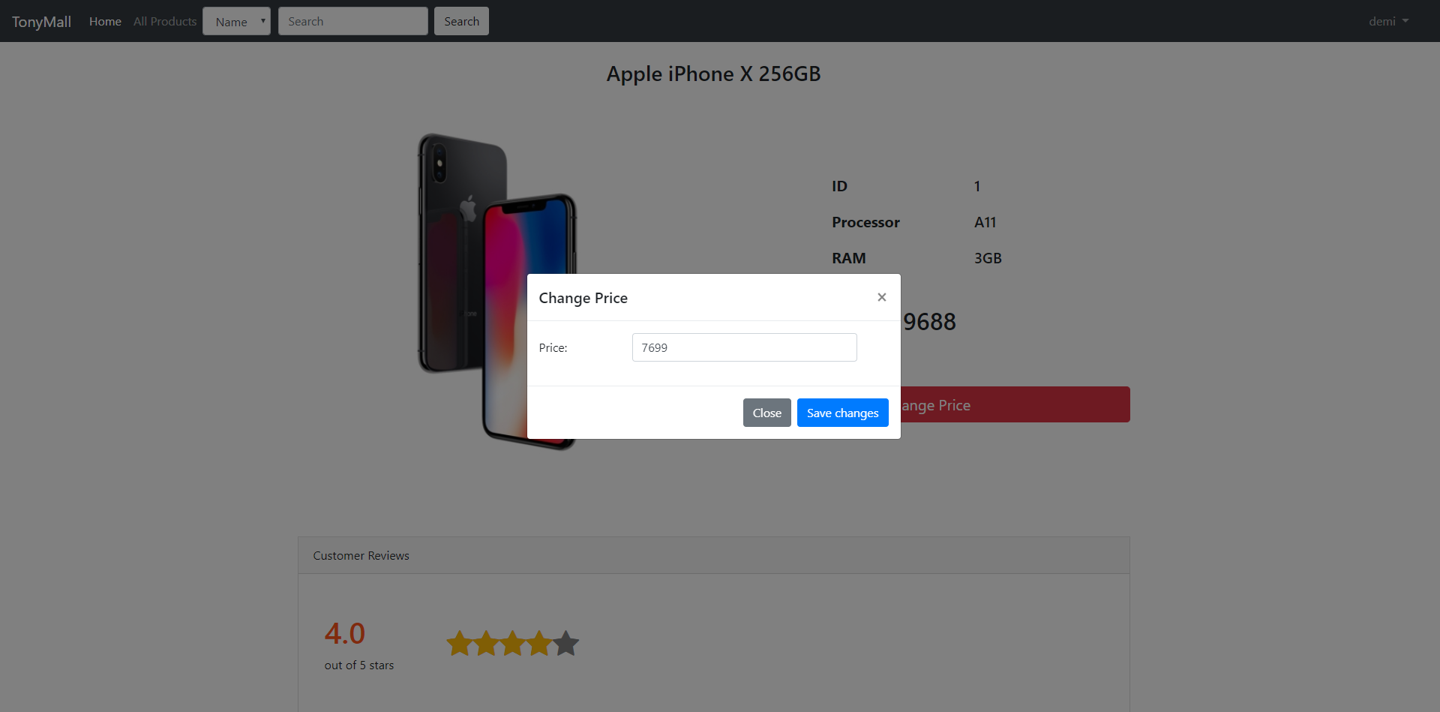

Slide 24
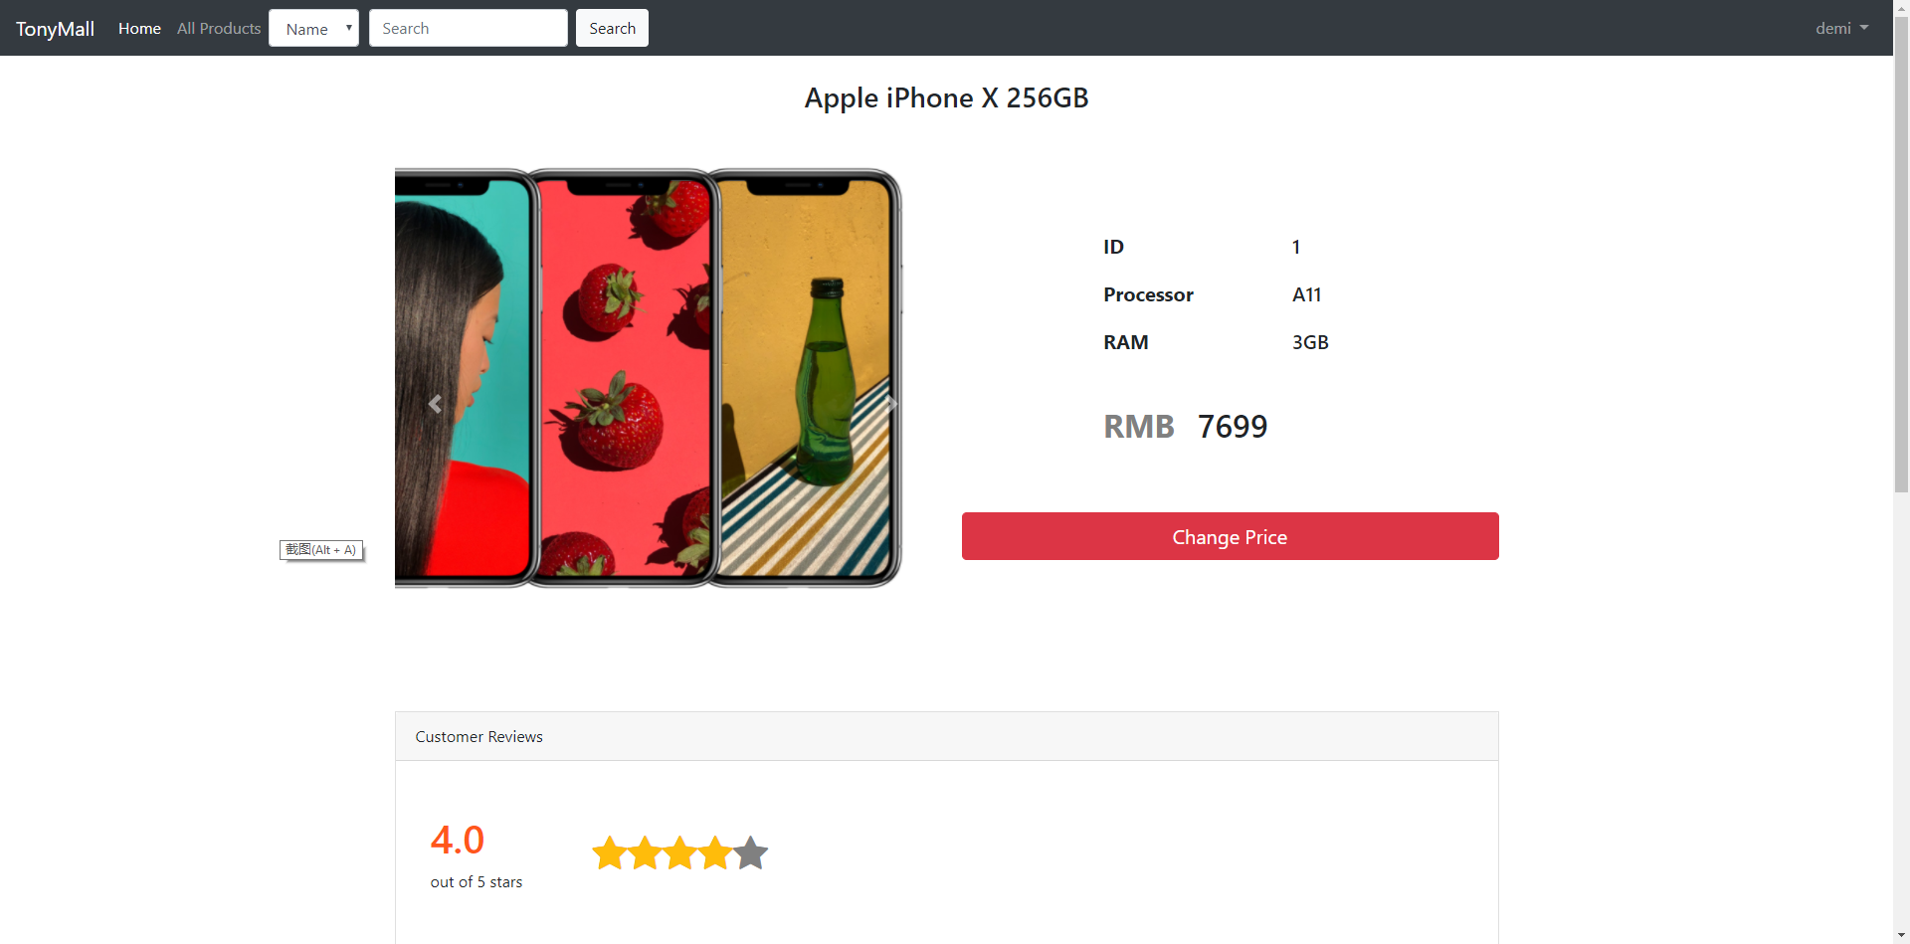

Slide 25
Purchase Order Processing

Slide 26
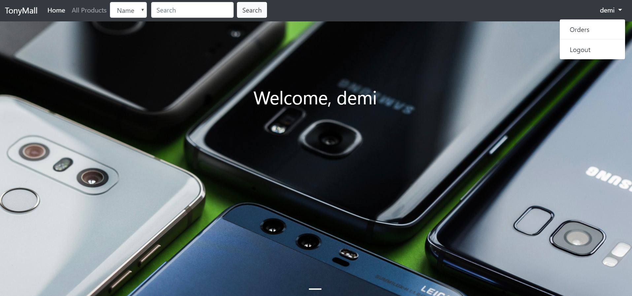

Slide 27
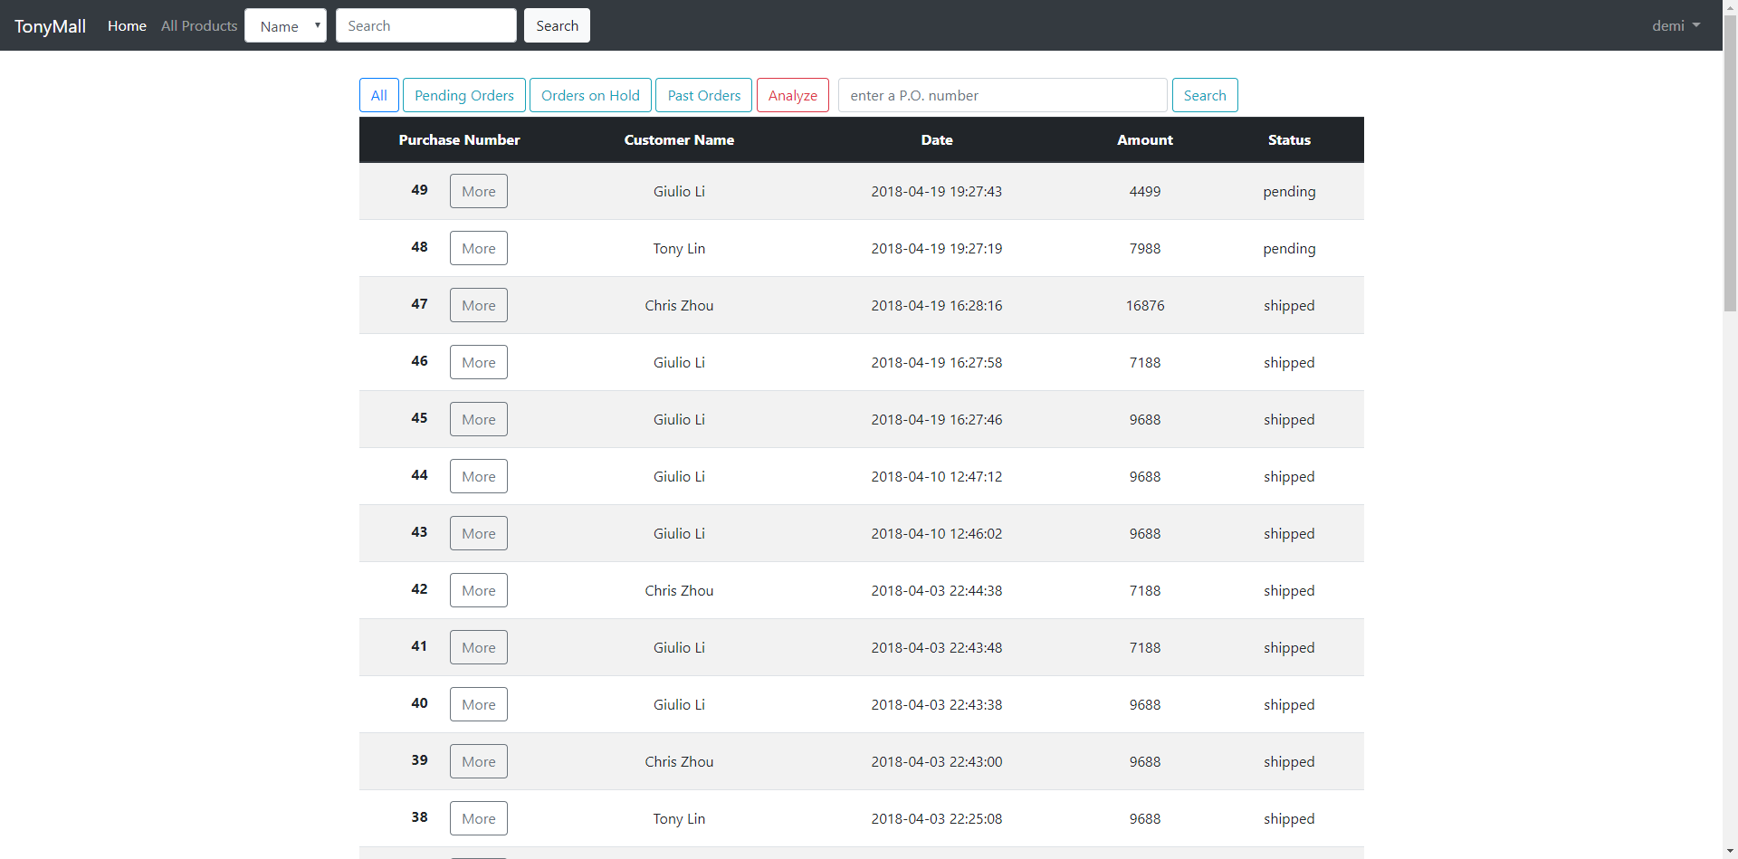

Slide 29
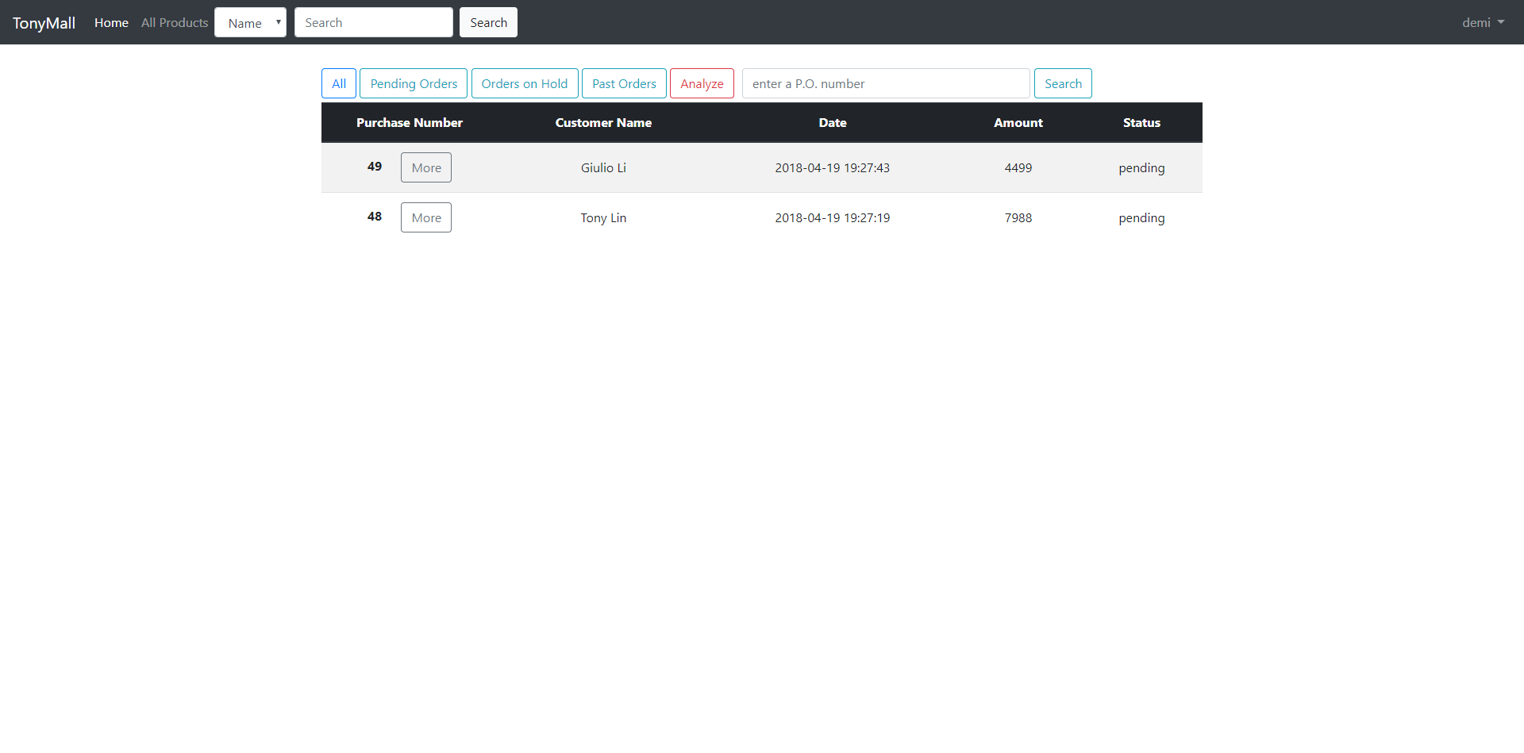

Slide 30
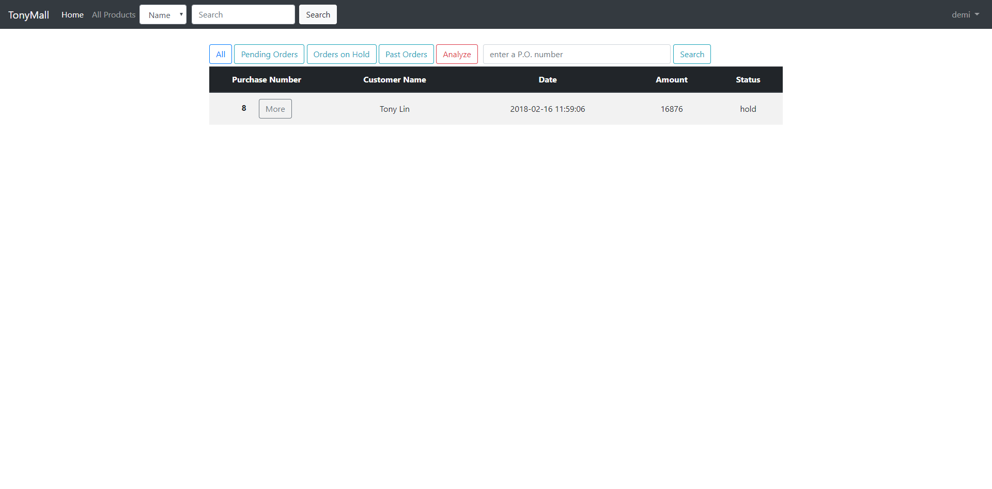

Slide 31


Slide 33


Slide 35
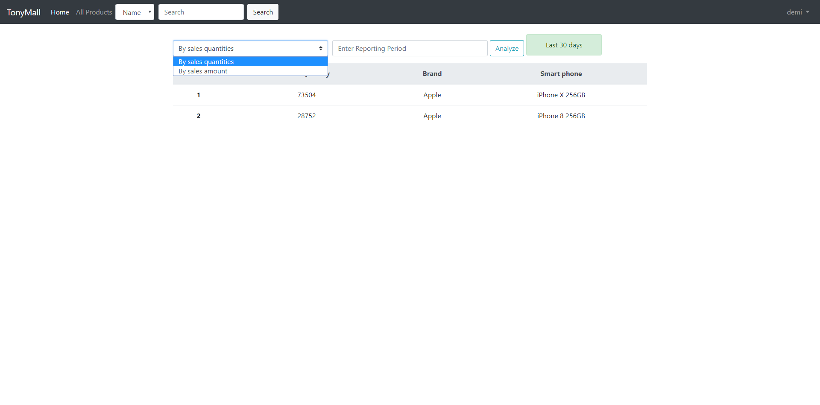

Slide 36
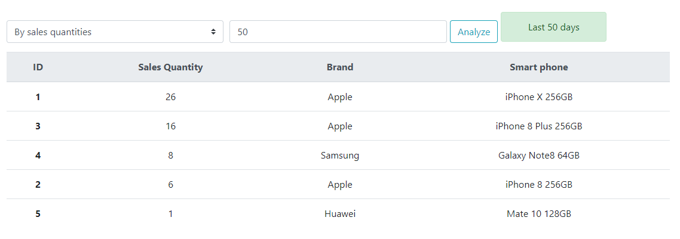

Slide 37
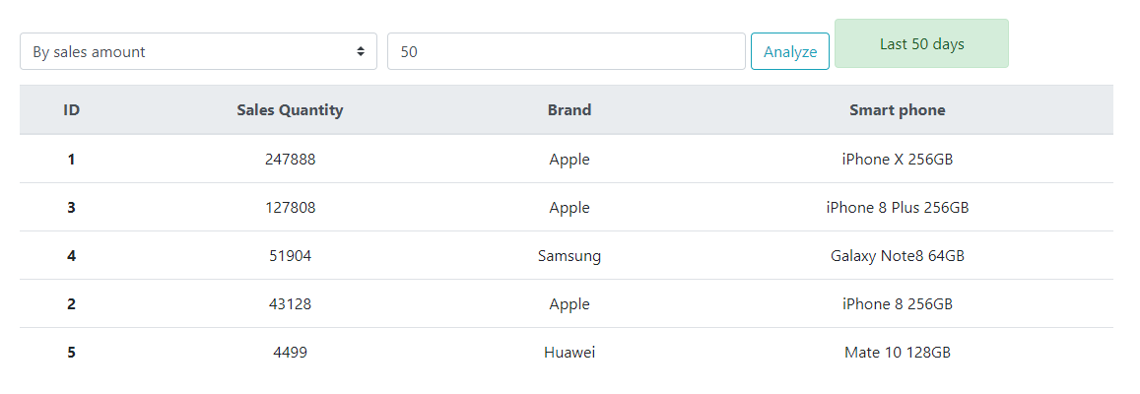

Slide 38
Conclusion & Future Work

Slide 39
Conclusion
We have achieved 32 functions in total in our Tonymall website.
It contains two main parts:
Customer part
Vendor part

Slide 40
Customer Part
Product list
Search products by name or brand
Detail page for each product
User registration, login and logout
Shopping cart
Purchase tracking
Modify purchase order status
Review and give star rating

Slide 41
Vendor Part
Display products
Search products through a product ID or name
Manage all purchase orders
Modify purchase order status
Change product price
Analyze sales of products

Slide 42
Future Work
Vendor part
Provide a platform for vendor to add or delete products and edit products information.
Customer part
Add a sorting by price button in product list page
Add a notification function for informing customers.

Slide 43
Thank you for your listening !

